Slide 1

Is this the Future of Gaming?
“This is video gaming on demand, where we deliver the games as a service, not something on a disk or in hardware. Hardware is no longer the defining factor of the game experience.”
-Steve Perlman, OnLive Founder & CEO

Slide 2
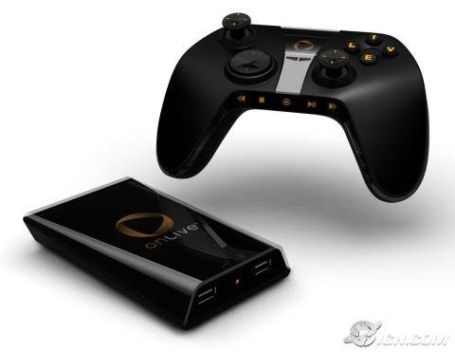
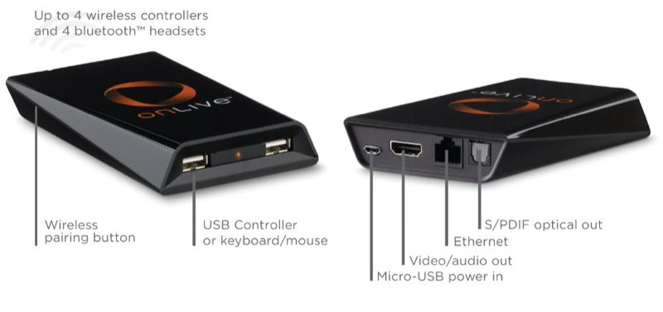
The Ultimate Online Gaming Service
A service as opposed to a console and hardware
MicroConsole(optional) and controller
Server compresses and streams game to your screen (Mac, PC, TV)
Can even run on a MacBook Air

Slide 3

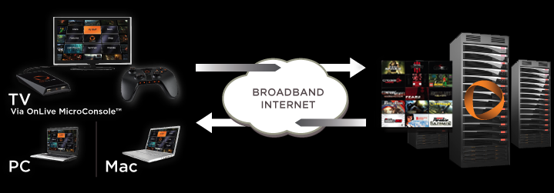
How It Works
Your machine connects to OnLive server where games are hosted
Game movements sent to server, information is compressed and sent back to your machine at 60 fps

Slide 4
Requirements for Service
Internet Requirements
Broadband Connection (DSL, cable modem, fiber, LAN )
TV Requirements
Standard TV – at least a 1.5 Mbps connection
HDTV resolution (720p60) - at least a 5 Mbps connection
Running through a TV (instead of Mac or PC) requires the OnLive MicroConsole and a couple of cables
Computer System Requirements
PC running a current version of Windows XP® or Vista®, or an Intel®-based Mac running a current version of OS X.

Slide 5

Potential Pitfalls
Response Time and Resolution Limitations
Network Bandwidth and Latency
Resuming Games with Cloud Computing
Reaching a Worldwide Audience
However…
OnLive Partners

Slide 6
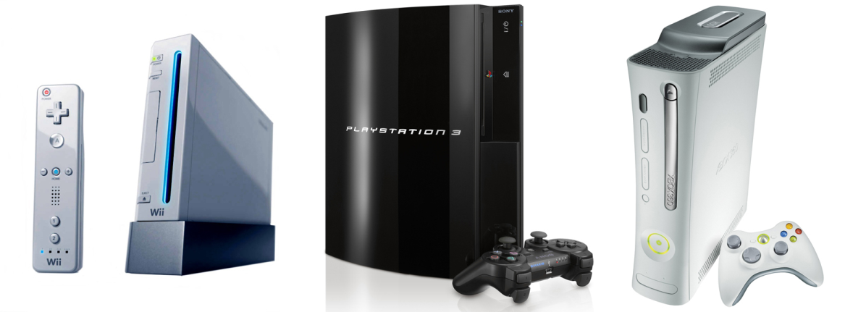

Questions to Consider?
What will happen to video game consoles like the PS3, Wii, Xbox360? Will this end the console wars?
How will gamers feel about buying games that are not hard copies?
What will this mean for game developers as well as game retail?

Slide 7
Works Cited
http://venturebeat.com/2009/03/23/steve-perlmans-onlive-could-turn-the-video-game-world-upside-down/
http://pc.ign.com/articles/965/965535p1.html
http://www.engadget.com/2009/03/24/onlive-killed-the-game-console-star/
http://www.gamasutra.com/php-bin/news_index.php?story=22875
http://pc.ign.com/articles/965/965535p1.html
http://www.onlive.com/index.html
COMING WINTER 2009

